Slide 1
Who does what in Eyecare??

Slide 2
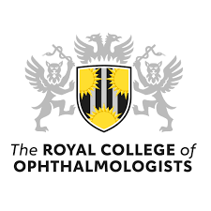
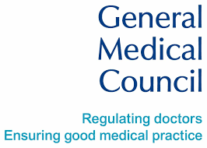
Ophthalmologist
Medically qualified
Specialist training is 7 years following 2 years general (foundation) doctor training
Governed by the General Medical Council
UK professional body is Royal College of Ophthalmologists

Slide 3
Provide wide ranging highly specialised medical eyecare
Prescribe medication
Carry out surgical and other interventional procedures
Oversee secondary care provision

Slide 4
Optometrist
Degree in Optometry followed by a pre-registration year and professional qualifying exams
Governed by the General Optical Council
Professional body is The College of Optometrists
Able to study for higher qualifications to increase their scope of practice including:
Independent prescribing
Medical Retina
Glaucoma
Low vision

Slide 5
Able to provide a prescription for glasses or contact lenses
Can carry out eye examinations and detect abnormality
If higher qualifications can manage low complexity cases independently but scope of practice is limited
Not medically or surgically qualified

Slide 6
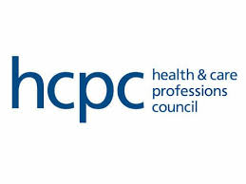
Orthoptist
Undergraduate degree in Orthoptics which includes clinical placements
Specialist in how eyes work together and eye movement disorders
Commonly work with children
Also work with people requiring stroke rehabilitation
Regulated by the Health and Care Professions council
Professional body is the British and Irish Orthoptic Society

Slide 7
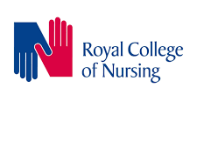
Ophthalmic Nurse
Registered Nurse following degree qualification
Training within Ophthalmology
No formal body specifically for Ophthalmic nurses
Can undertake higher training to carry out interventions, prescribe certain medications and assess and manage patients
Governing body is the Nursing and Midwifery Council
Professional body is the Royal College of Nursing

Slide 8
Multi-disciplinary team working
All the eye care professionals are essential in providing care
Expansion of the use of the MDT and developing new ways of working will help address the difficulties in capacity currently faced in Wales
MDT sub-committee in the Clinical Implementation Network addressing inequality in accessing training dependant on profession and standardising job descriptions for extended roles in secondary care in Wales.

Slide 9
Primary or secondary care
Primary care
Secondary care
Optometrists
GP
Ophthalmologists
Orthoptists
Optometrists
Nurses

Slide 10
Primary or secondary care
Primary care
Secondary care
Optometrists
GP
Ophthalmologists
Orthoptists
Optometrists
Nurses

Slide 11
How Hospital Optometry is the missing link in integrated care
Optometry is the only profession that works in both primary and secondary care
Hospital Optometrists may only work in Hospital but some may also work in primary care
Hospital optometrists provide more complex care than that can be provided in primary care
They work closely with other secondary care professionals to manage complex cases that have needs that can only be met in the hospital
They are a crucial part of a functional Hospital eye service

Slide 12
Hospital optometry provides a direct link with primary care as they have a full understanding of both aspects of care
The can create seamless pathways across the entire care pathway
They are the key to developing the full range of integrated pathways that will allow more patients to be able to receive care closer to home provided by community optometry
Secondary care Optometry in Wales has historically been underfunded and understaffed with only a small number of units having a functioning department

