Slide 1
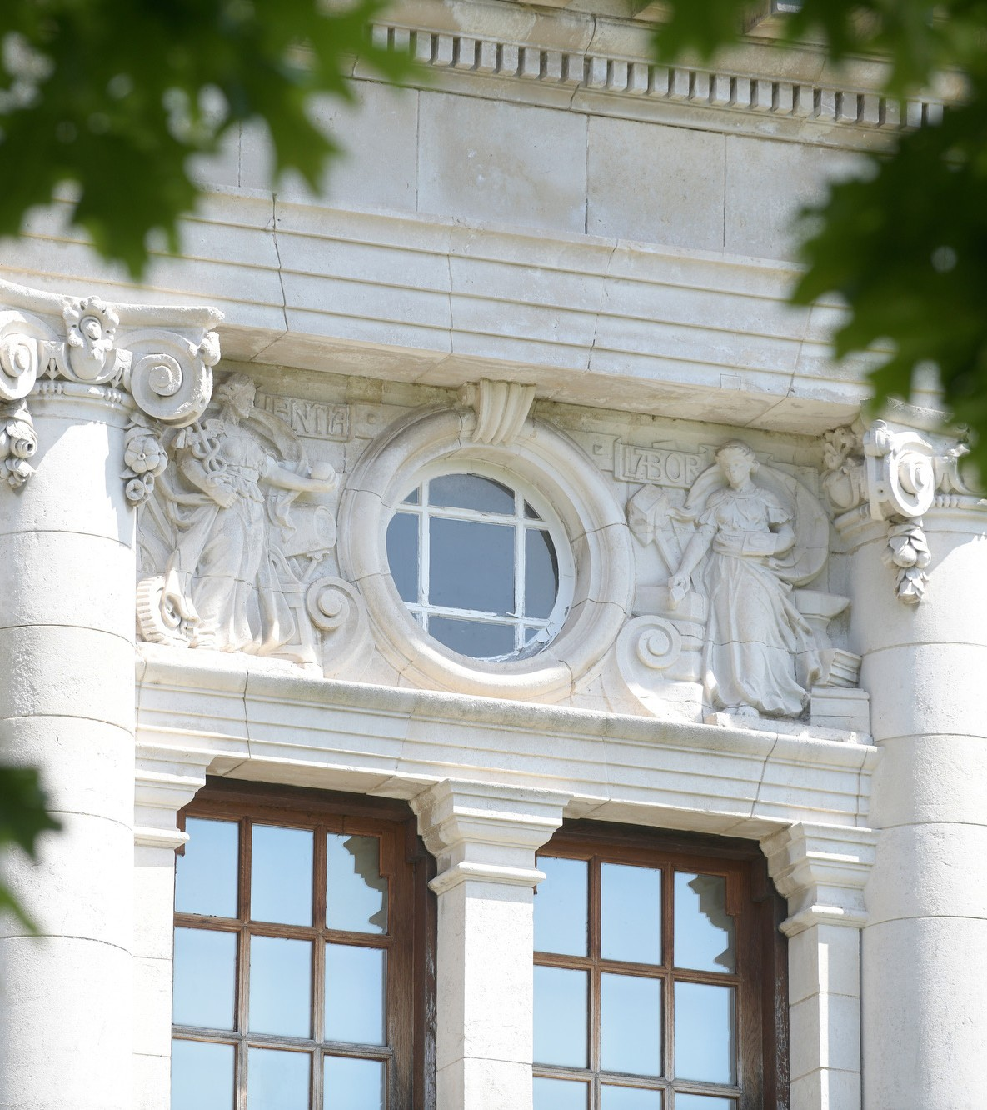
Hospital to Community:
Educating the eye care workforce.
Prof Barbara Ryan MBE

Slide 2
Ophthalmology simulation suite.

Slide 3
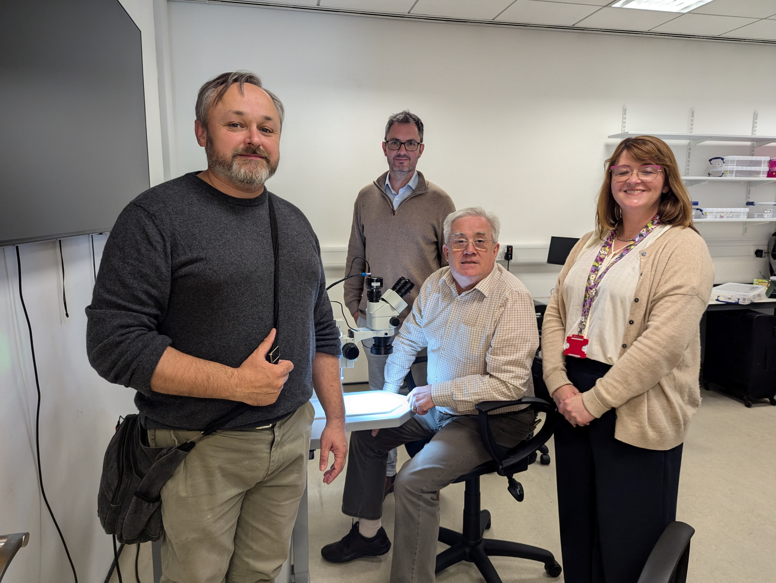

Slide 4
Ophthalmology simulation training.
In surgery, there is good evidence that simulation training gives better results for patients from the outset and less harm.
Surgery in ophthalmology needs a lot of dexterity and co-ordination.

Slide 5
The Royal College of Ophthalmologists curriculum now requires simulation training.
Wales didn’t have a unit.
Simulation is important to ensure excellent ophthalmologists in Wales.
Attract trainees in ophthalmologists to Wales.

Slide 6
WG funded simulation suite for ophthalmology
Based in the School of Optometry and Vision Sciences.
Launched this year in August.
Hope to encourage multi-disciplinary education in time.

Slide 7
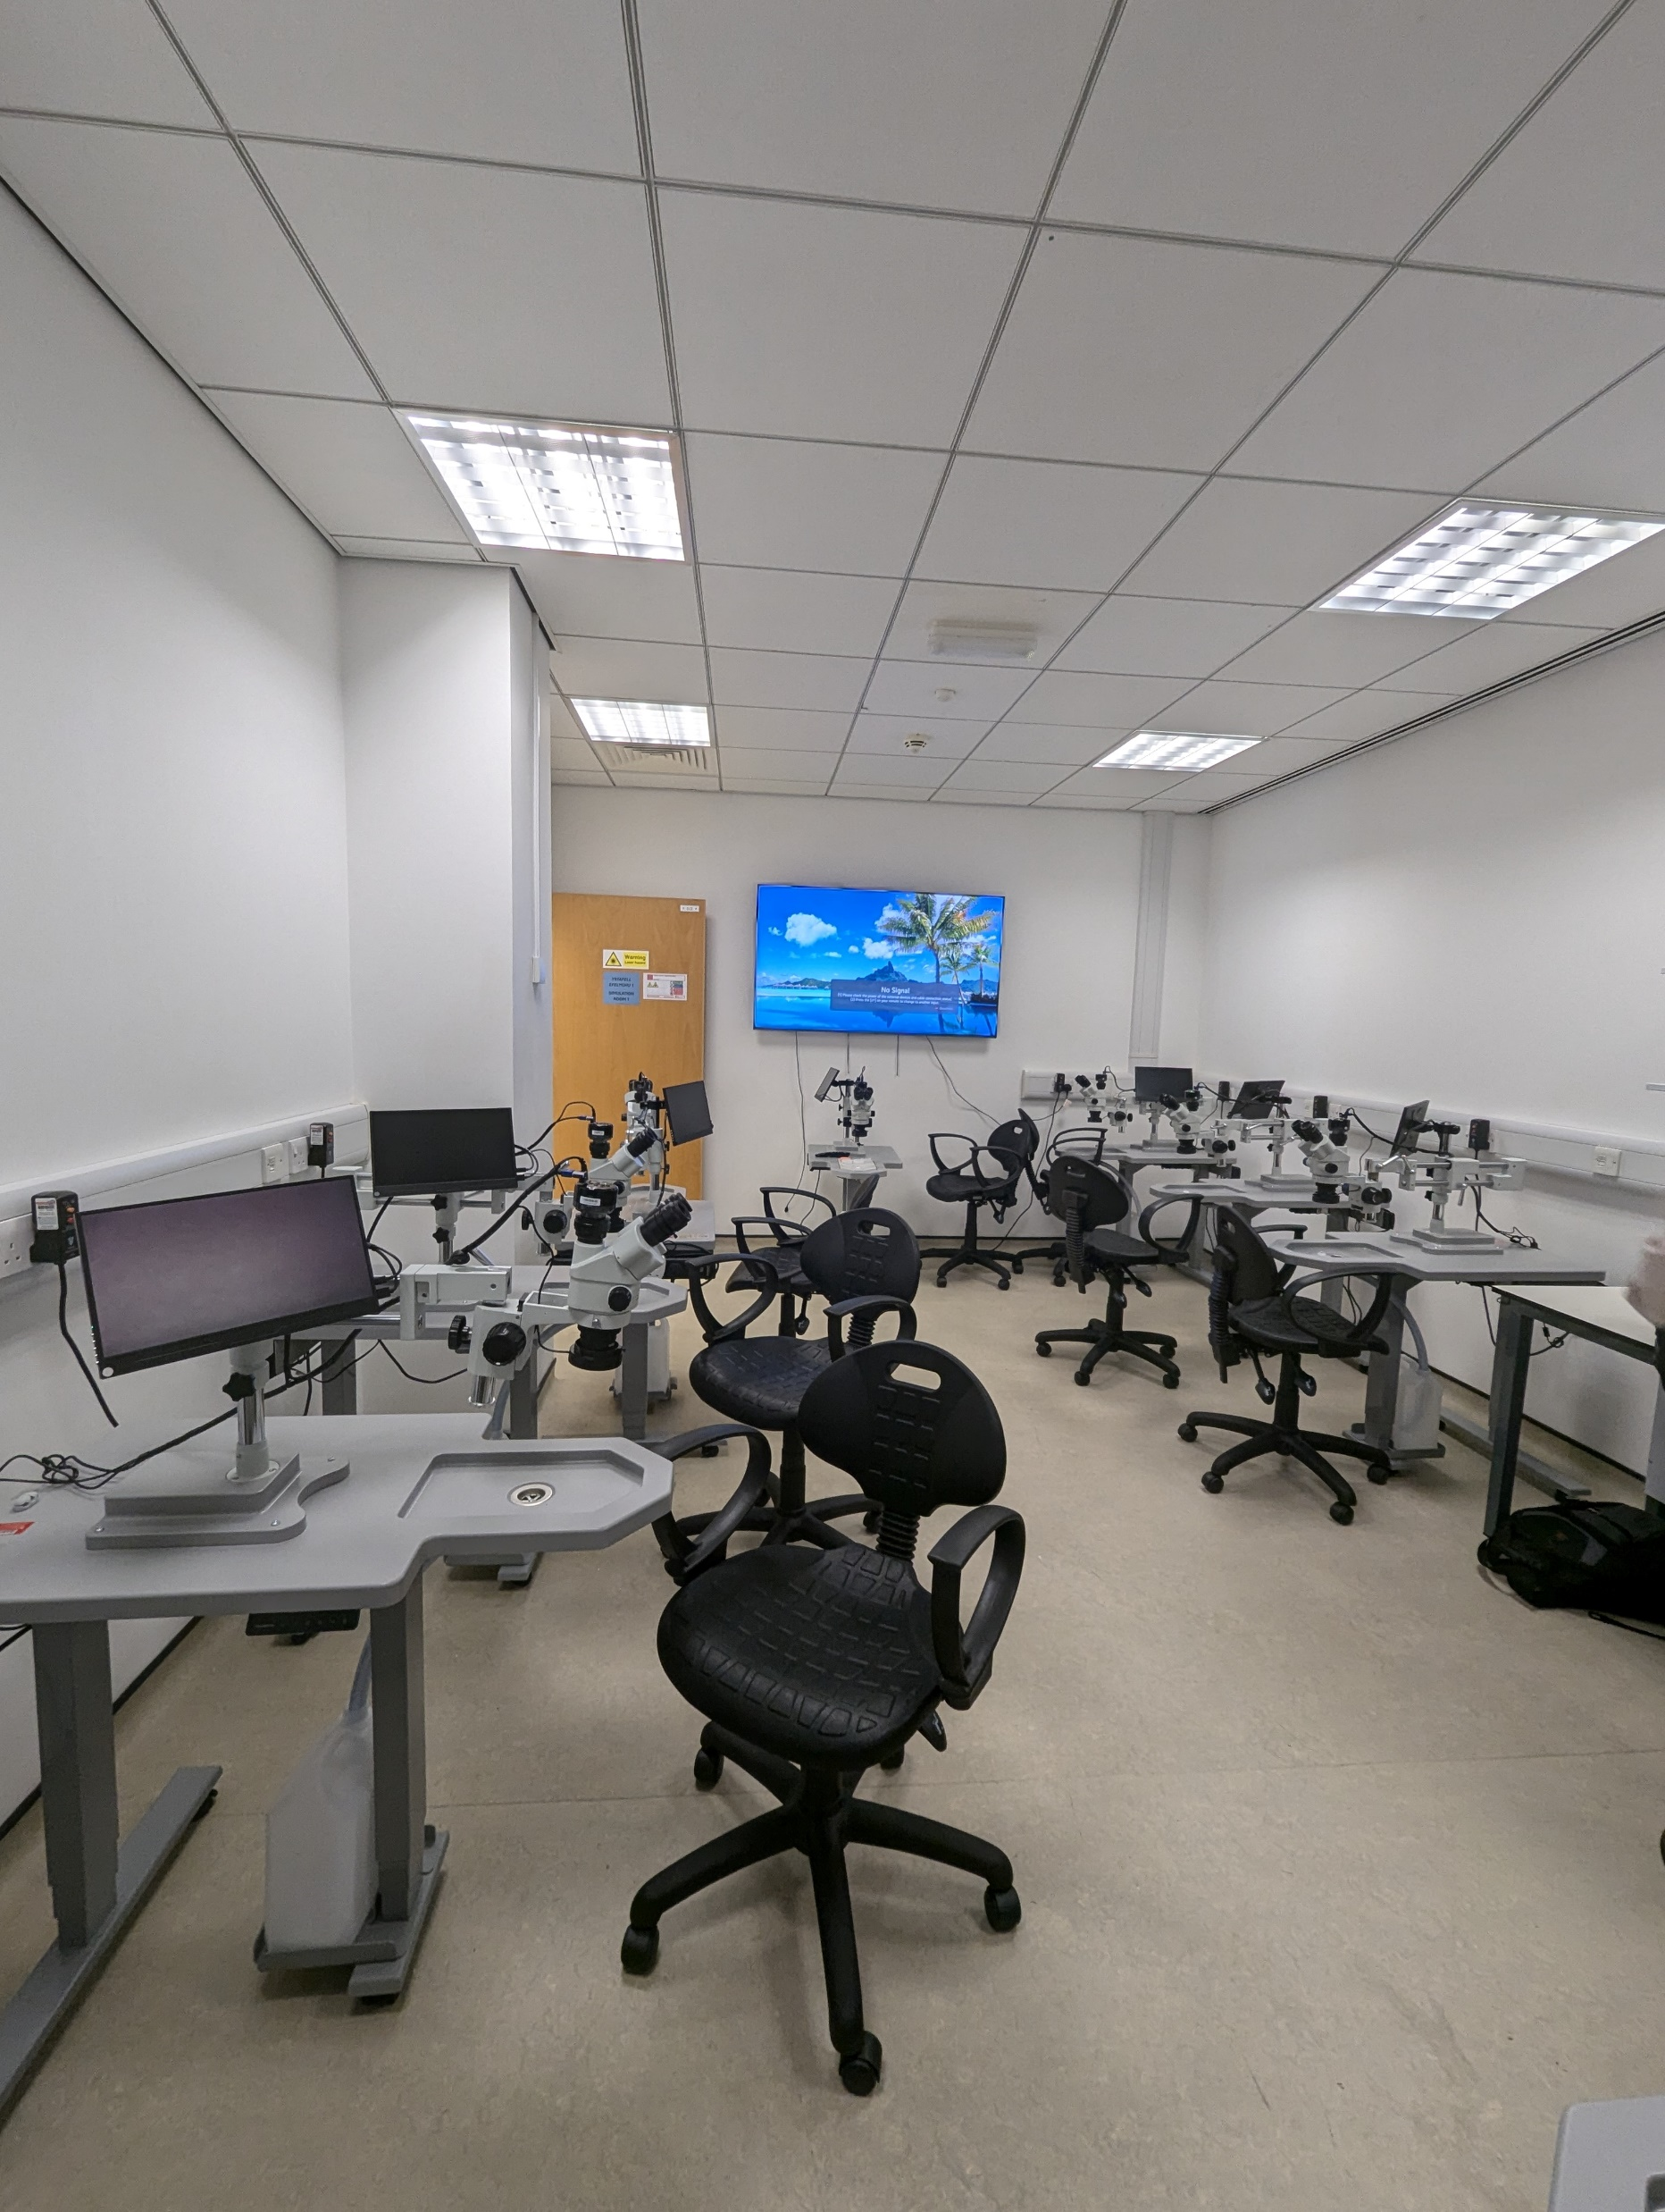

Slide 8
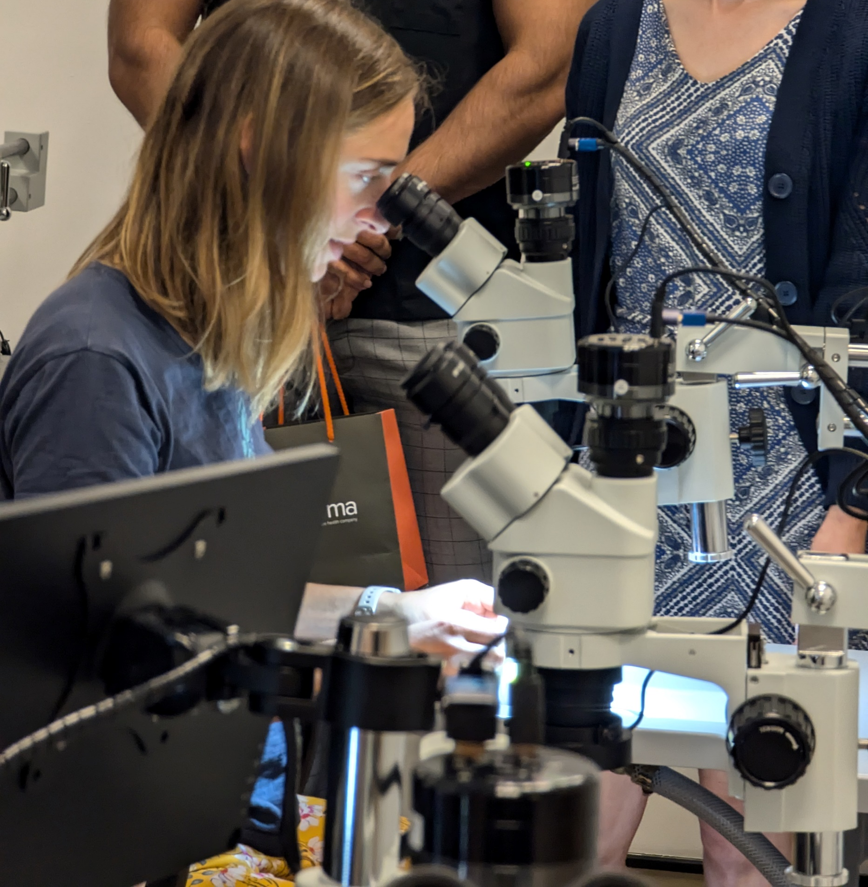

Slide 9
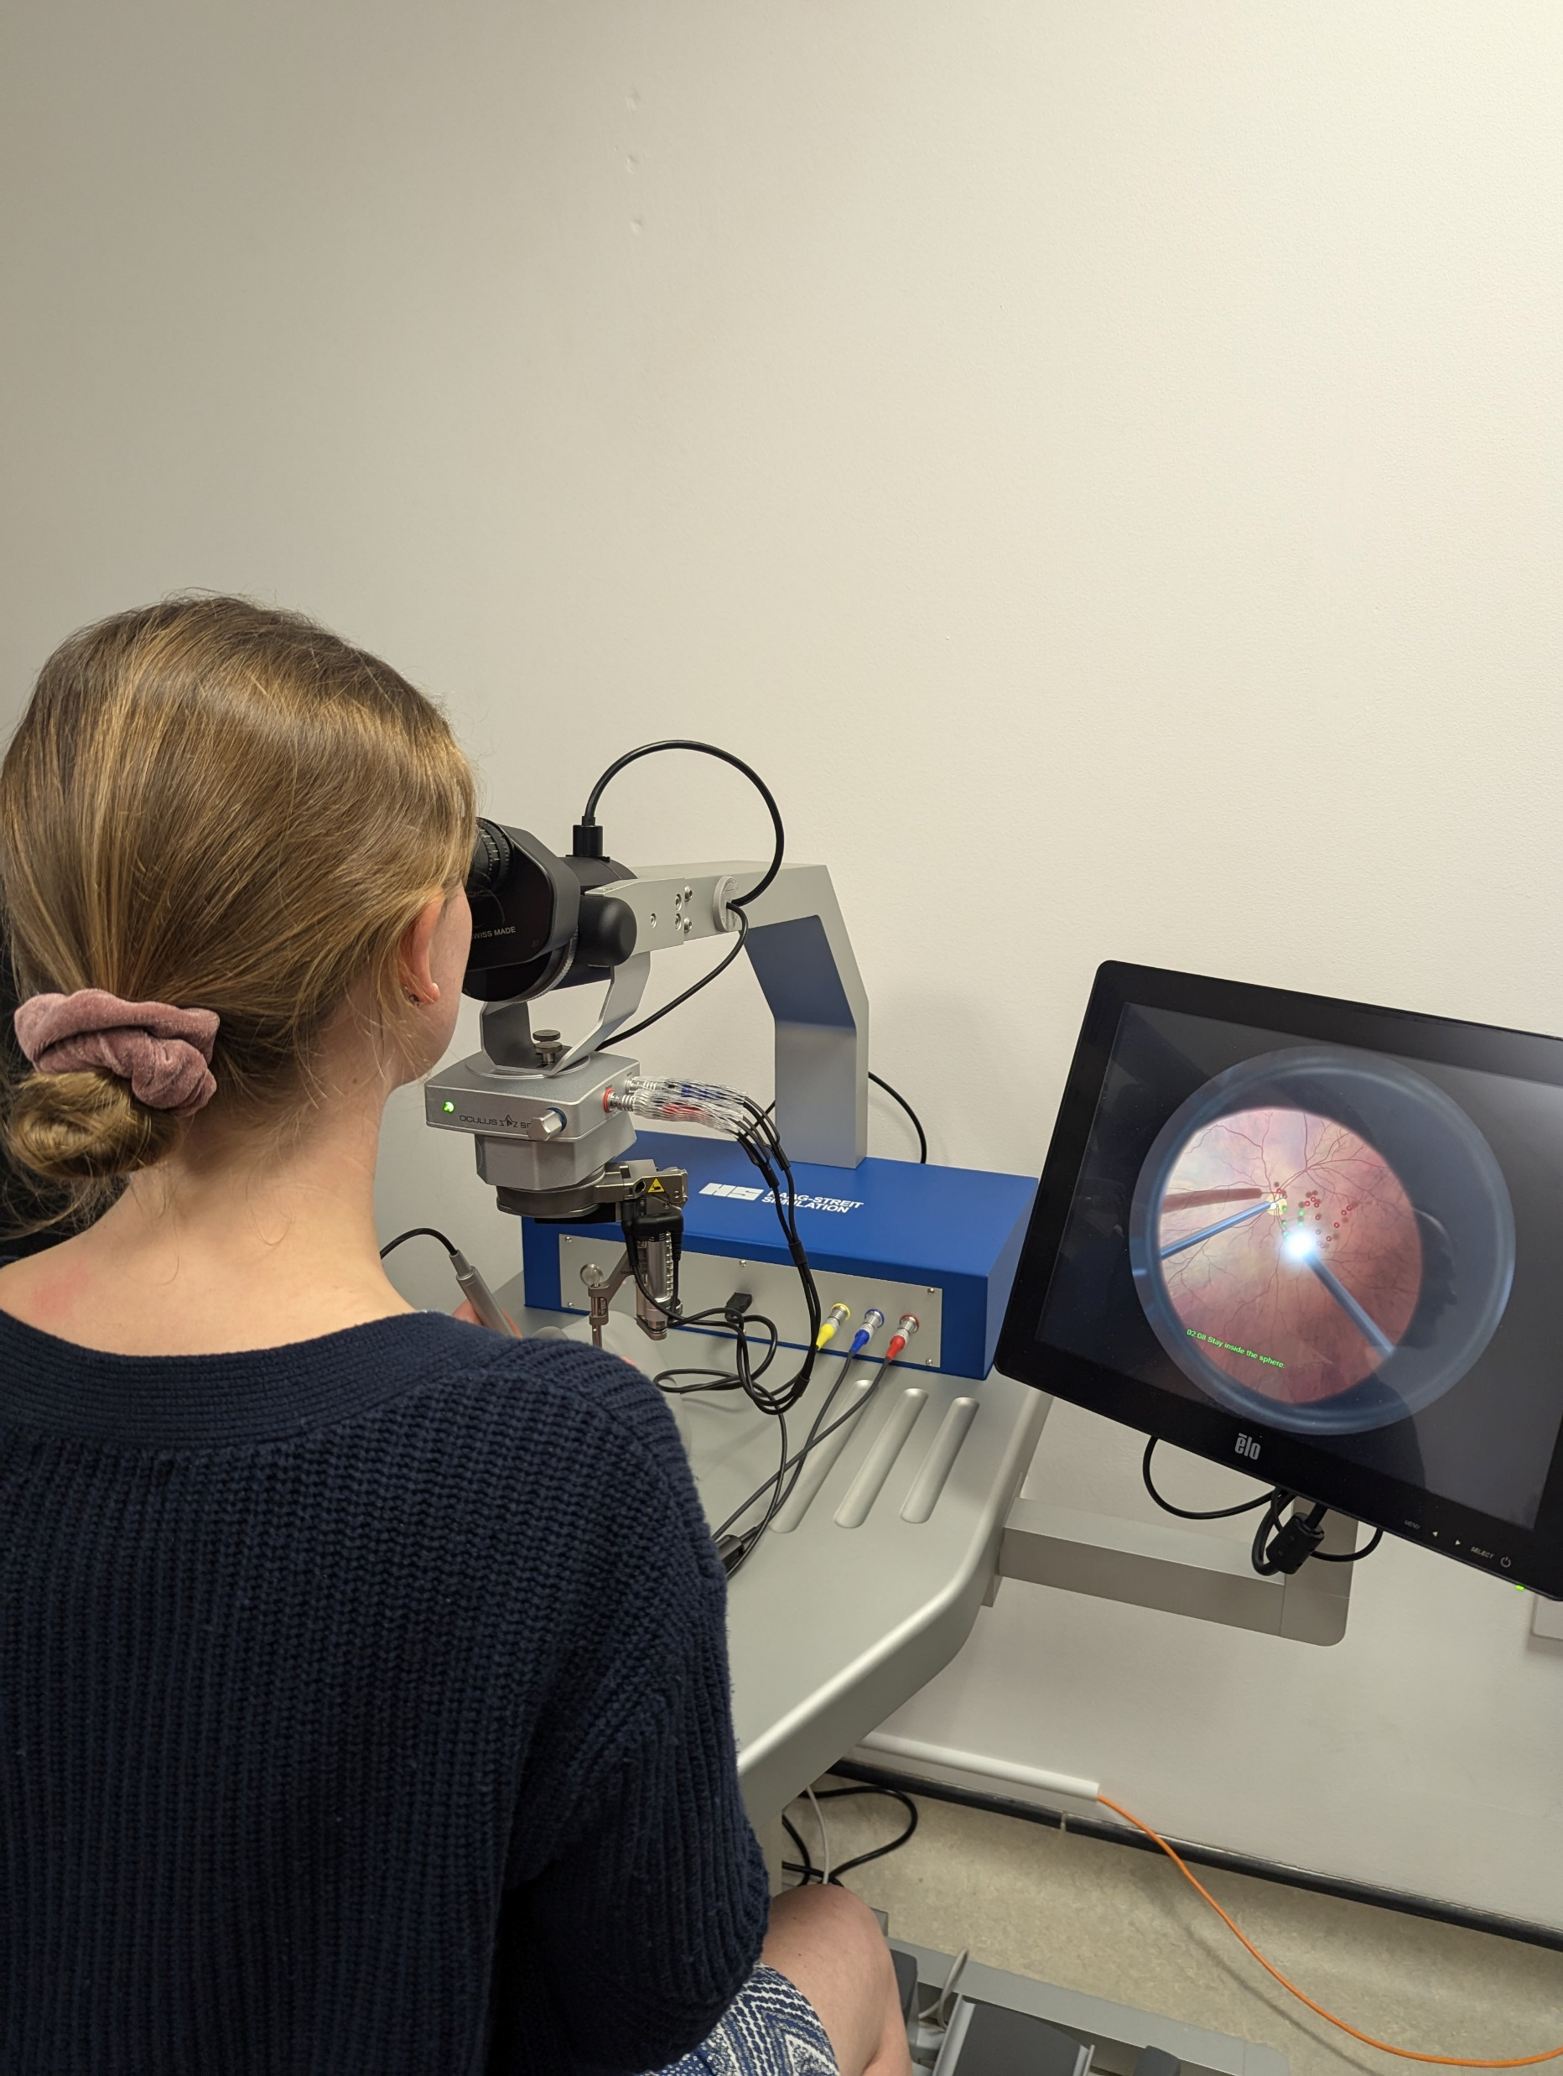

Slide 10
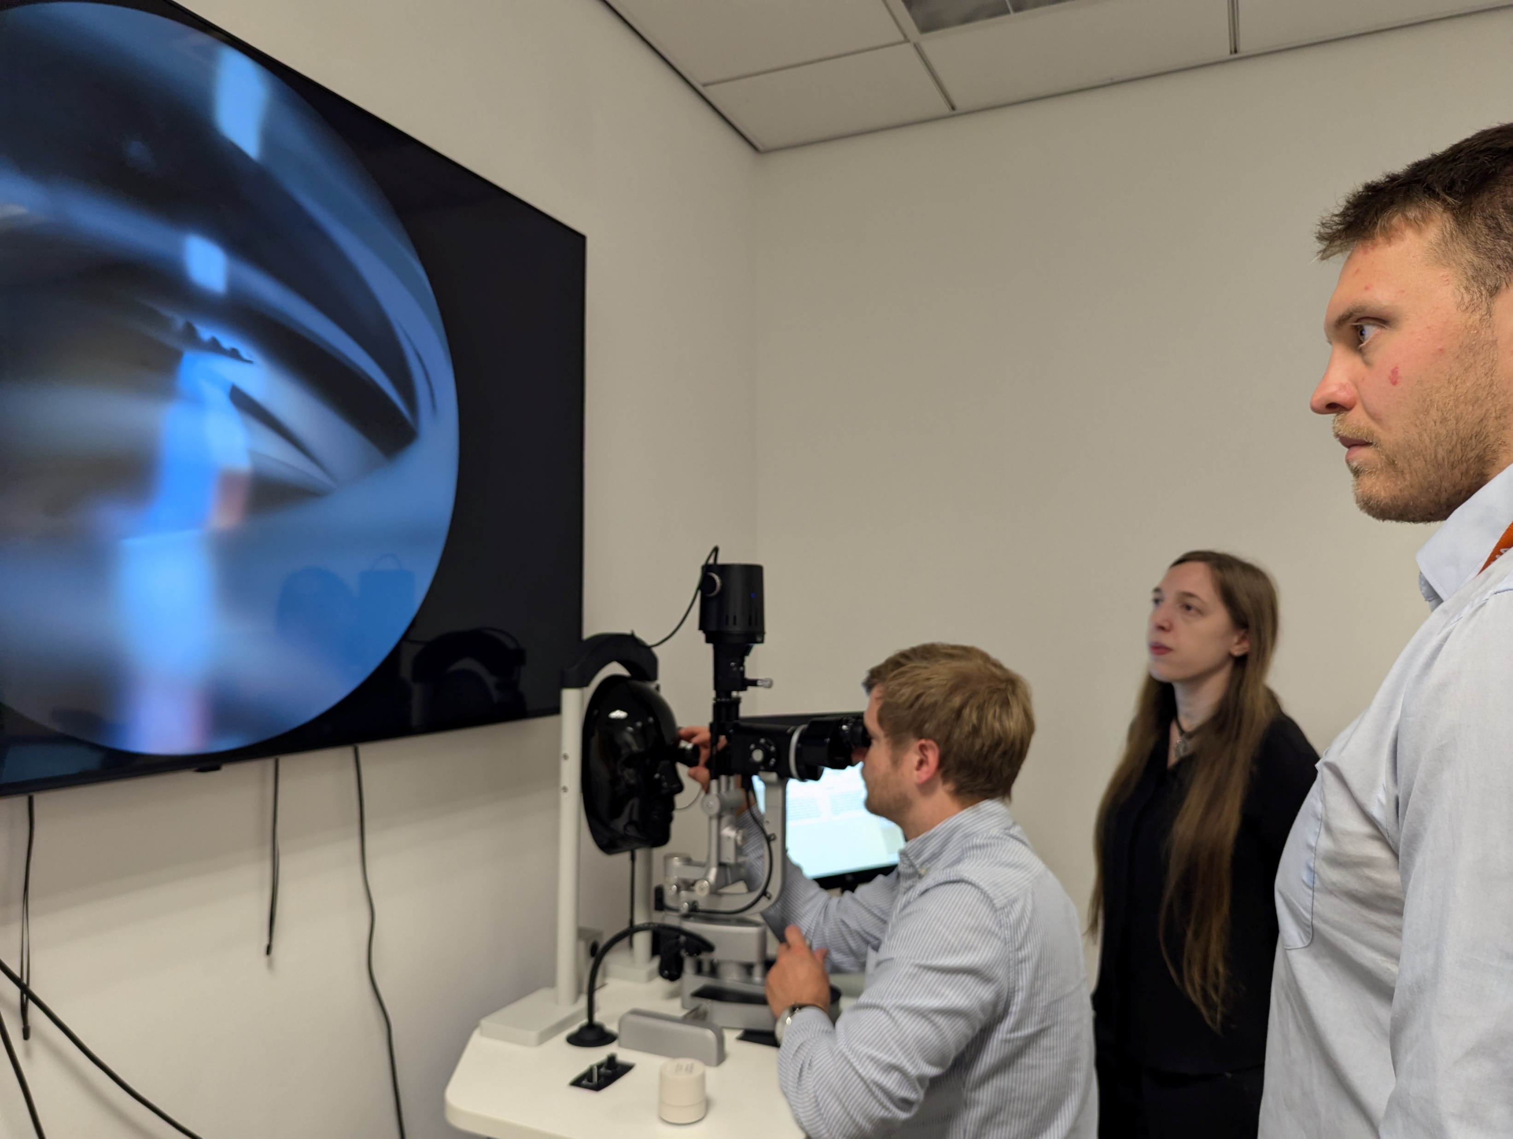

Slide 11
Teach and Treat Clinics

Slide 12
Reduce hospital waiting times.
Achieve similar patient experience.
Release capacity in the hospital eye service and for GPs.
Using primary care optometrists with higher qualifications to do more will:
Ryan, Barbara, Mari Jones, Pippa Anderson, Rhiannon Reynolds, Rebecca EM Nicholls, Katherine Cullen, Mark Davies, Rachel North, Bablin Molik, and Carolyn Wallace. "Hospital to community in Wales: What is the value of optometrists playing a greater role in managing neovascular AMD and glaucoma in primary care?." Ophthalmic and Physiological Optics (2024).
Cottrell, Paul, Rachel North, Nik Sheen, and Barbara Ryan. "Optometry independent prescribing during COVID lockdown in Wales." Ophthalmic and Physiological Optics 42, no. 6 (2022): 1289-1303.

Slide 13
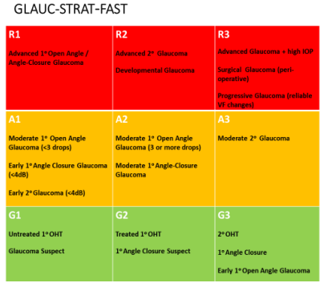
Clear guidance of which patients’ optometrists can manage safely

Slide 14
Clear hierarchy of professional qualifications for optometrists
Diploma Glaucoma + Independent Prescribing | Over 400 glaucoma cases & 24 sessions IP
Higher Certificate Glaucoma + Independent prescribing | Over 150 glaucoma cases & 24 sessions IP
Higher Certificate Glaucoma | Over 150 glaucoma cases
Certificate Glaucoma | Assessment of skills

Slide 15
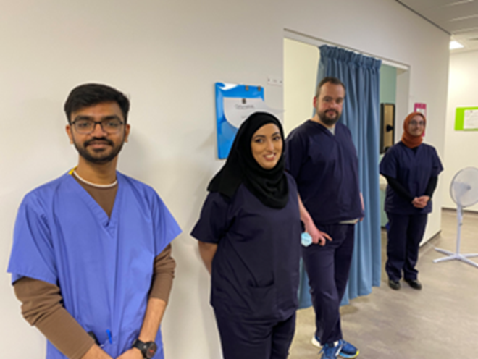
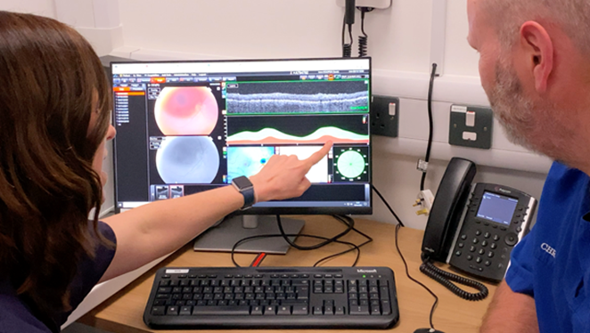
Glaucoma, independent prescribing and medical ‘teach and treat’ clinics :

Slide 16

Short term benefits
Patients seen in primary care, not hospital
Sept 2021 - July 2023:
1300 glaucoma patients seen
    -17% referred to hospital
  -8% discharged
  -77% monitored in primary care
April 2023- March 2024:
747 medical retina patients
    -31% referred to hospital
    -42% discharged
    - 27% monitored in primary care

Slide 17
Short term benefits
Patients seen in primary care, not hospital or GP
April 2024- Sept 2024:
579 acute eye care patients seen
    -less than 10% referred to hospital

Slide 18
Medium term benefits
More optometrists (in South East Wales) involved in glaucoma referral and monitoring pathways
Sept 2021 - July 2023:
12 optometrists with Higher Certificate Glaucoma
April 2024- Sept 2024:
23 optometrists IP placements

Slide 19
Longer term benefits
Optometry practices managing increasing numbers of glaucoma cases because they have trained workforce.
Optometrists providing some placement experience in primary care.
Undergraduate optometrists qualifying with Prof Cert Glaucoma, Med Ret and theory of IP

Slide 20
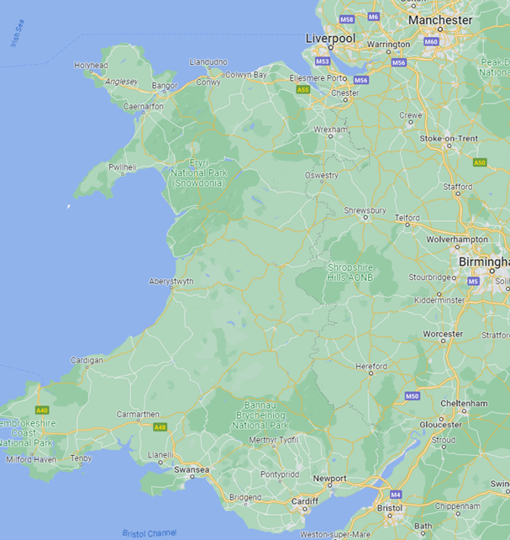

Holywell – 2 IP completed and 2 in training
Deeside – 4 Glaucoma placements started (30/10/25)
Neath Port Talbot – 4 Glaucoma
Swansea - IP and Med Ret started this week!
Holywell
Deeside
Neath Port Talbot
Swansea
Cardiff

Slide 21











Diolch Thank you

