Slide 1
Welsh Eye Care Service Triage (WECS)
Rachel Whitehall
Assistant Director Planned Care
Betsi Cadwaladr Health Board

Slide 2
WECS
What the service provides
Triage of backlog in North Wales
Prospective Triage

Slide 3
Welsh Eye Care Service
Eye Health Examinations Wales (Band 1)
Extended to include referrals by DRSSW and Dry AMD monitoring
EHEW Further investigations/examinations (Band 2)
Enabling patients to have additional investigations so that the optometrist can further inform their referral, investigate clinical findings or determine management after a sight test (GOS or private)
EHEW Follow-up examination (Band 3)
Enabling patients to be followed-up after they have had an initial appointment for an EHEW e.g. re-assessment of a patient with a non-resolving red eye, removal of more ingrowing eyelashes, investigation of dry eye following treatment.

Slide 4
Referral review
New Referral Review
Optometrists undertaking sessions at Patient Access Booking Centre to review new referrals
Follow up appointment Review
Optometrists undertaking sessions in the ophthalmology departments to review patient records

Slide 5
New referral Optometrist triage
Refer to WECS optometrist
Remain on the Ophthalmology Waiting List
Letter sent to patient advising them that they would benefit from a WECS appointment
List of local WECS accredited optometrists sent to patient for them to make an appointment
No change to the patient’s placement on the Ophthalmology Outpatient waiting list
Patient is seen according to current waiting times

Slide 6
Review appointment triage
Appointment with Ophthalmologist
Clinically prioritise appointments
Escalate appointments
Appointment with WECS optometrist
Patient advised to see a WECS accredited optometrist
List of WECS accredited optometrists provided
Discharge
Duplicate waiting entries on waiting lists/condition resolved
No need to be seen by Optometrist /Ophthalmologist

Slide 7
New referrals triaged 2013/14
Number of referrals triaged to WECS (24%)
East 236
Central 229
West 314
Health Board 779

Slide 8
Review referrals triaged 2013/14
 | Number of referrals triaged to WECS | Number of referrals discharged | Number of patients to be seen in secondary care | Total triaged
East | 151 | 33 | 576 | 760
West | 176 | 109 | 350 | 635
BCU total | 327 | 142 | 926 | 1,395
 | 23% | 10% | 66%

Slide 9
Electronic New Referral Triage
Commenced electronic WECS triage system in August 2014
3 Optometrists with access to all referrals electronically
All referrals to be triaged within 48 hours of receipt

Slide 10
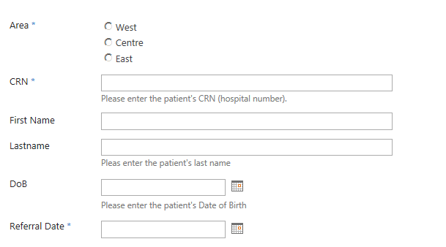
Electronic triage – Patient Access and Booking Centre

Slide 11
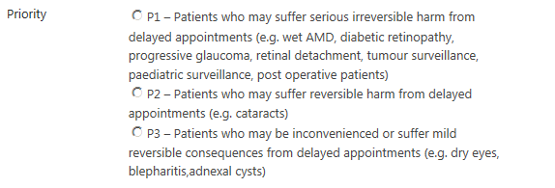
Electronic triage -WECS Optometrist
Clinical Prioritisation

Slide 12
Electronic triage -WECS Optometrist
Triage options
Refer to WECS accredited optometrist
Refer to Low Vision services practitioner
Refer to Secondary Care
Return to referrer – insufficient information
Return to referrer – North Wales Cataract Pathway not met

