Slide 1
Stroke and Vision
Matt O’Grady
Policy, Information and Campaigns Officer, Wales
Stroke Association

Slide 2
Stroke Survivors in Wales
Over 67,000 stroke survivors in Wales
2% of population
1.2 million across the whole of the UK
7,400 strokes per year in Wales
Projected to rise by 50% in Wales in next 20 years
Fourth biggest killer in the UK
Leading cause of disability
Notes:
Overall, there are more than 100,000 strokes in the UK each year; that’s around one stroke every five minutes. In Wales there are around 7,400 strokes per year.
Stroke can have a sudden and massive impact on your life. It can rob you of your speech and your ability to walk. It can also affect your vision, memory, concentration and your emotions.
In fact, stroke causes a greater range of disabilities than any other condition.
In England, Wales and Northern Ireland, almost two thirds of stroke survivors leave hospital with a disability.
This can all have a huge impact on your independence, confidence and emotional wellbeing, which can have a significant knock-on effect on your work and family life.
Thanks to improvements to stroke care, you are now more likely to survive a stroke compared to 20 years ago. But sadly, stroke is still the fourth biggest killer in England and Wales.
Each year it kills more men that prostate cancer and twice as many women as breast cancer.
In Wales, stroke kills more than 2,000 people every year.

Slide 3
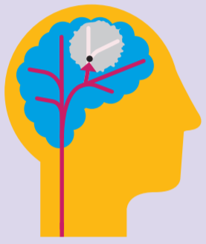
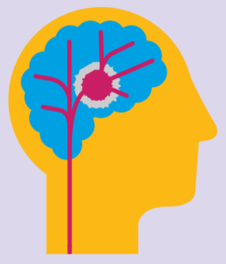
What is a stroke?
Blockage: 85%
Bleed: 15%
Notes:
What is a stroke?
A stroke is a brain attack. It happens when the blood supply to part of your brain is cut off. Without blood your brain cells can be damaged or die.
There are two main types of stroke:
Most strokes [around 85%] are caused by a blockage, such as a clot, which cuts off the blood supply to the brain. This is an ischaemic stroke.
Strokes can also happen because of a bleed, caused by a burst blood vessel within or on the surface of the brain. This is a haemorrhagic stroke.
Strokes caused by bleeds are not as common as strokes caused by a blockage, but they can be much more serious and are associated with a higher risk of dying within the first three months and beyond.
A TIA, more commonly known as a mini-stroke, is where the symptoms cease within 24 hours. Recently in the news as former US olympian Michael Johnson suffered one. However despite the name mini it is important to remember these are still very serious. 1 in 12 of those who have a mini-stroke will have a full stroke within a week so it really is an important warning. Also, there is no way of knowing whether a mini stroke is a full stroke until the symptoms have subsided, so at the time it has to be treated as the same level of emergency.
Strokes can strike anyone, at any time. While there are certain factors which increase the risk of stroke, they can still occur in people of any age, any level of fitness, even babies and children.

Slide 4
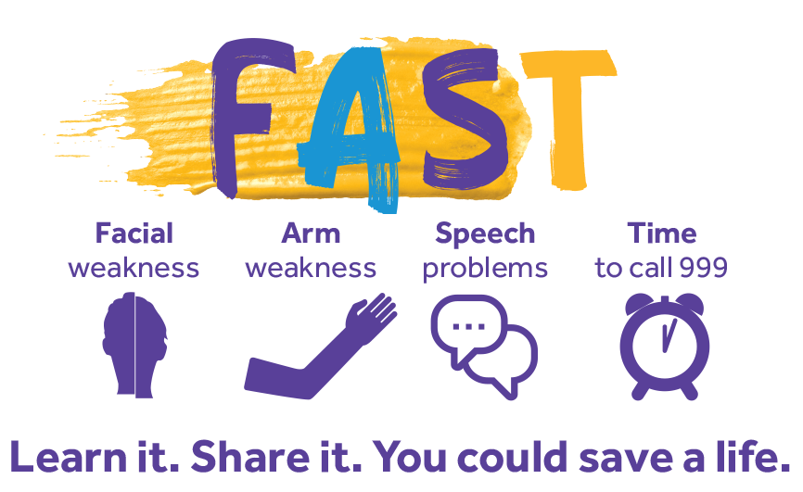
Do you know the FAST test?
Notes:
Every second counts when you are having a stroke. Recognising the signs and calling 999 for an ambulance is crucial. The quicker a person arrives at a specialist stroke unit, the quicker they will receive appropriate treatment.
To help more people to recognise the signs and symptoms of stroke, the Stroke Association helped to fund the development and spread awareness of the FAST test.
Face: Look at the person’s face and ask them to smile. Has their face fallen on one side?
Arms: Ask the person to raise both of their arms and keep them there. Are they unable to raise one arm?
Speech: Ask the person to tell you their name, or say ‘hello’. Is their speech slurred?
Time: to call 999 if you spot any of the above signs.
If you recognise any one of these signs in some one or yourself, always call 999.
Learn it and share it with your friends and family, as it could help you to save a life.

Slide 5
Other signs of stroke
Sudden weakness or numbness on one side.
Difficulty finding words or speaking in clear sentences.
Sudden blurred vision or loss of sight in one or both eyes.
Sudden memory loss or confusion and dizziness, or a sudden fall.
A sudden, severe headache.
Notes:
FAST tells you the main signs of a stroke, but there are some more to look out for:
sudden weakness or numbness on one side, including legs, hands or feet.
difficulty finding words or speaking in clear sentences.
sudden blurred vision or loss of sight in one or both eyes.
sudden memory loss or confusion and dizziness or a sudden fall.
a sudden, severe headache.
Again, if you spot any of these signs of a stroke, don't wait. Call 999 straight away.
Ambulance paramedics are trained in stroke, and will take you or the person having the stroke to the best hospital for specialist treatment.

Slide 6
Stroke Risk Factors
Lifestyle
Age
Family History
Ethnicity
High Blood Pressure
Atrial fibrillation
Diabetes and pre-diabetes
High cholesterol
Notes:
Lifestyle – Smoking and drinking are both high risk factors for stroke, with smoking doubling someone's risk of stroke.
Age – Unfortunately, at least until the Stroke Association agrees to fund a time machine, not something we are able to control. But getting older increases the risk of stroke as the arteries in your body become less elastic.
Family history – If other members of your family have experienced stroke or high blood pressure then this also puts you at a higher risk as well and knowing this helps you take the steps to control those other risk factors.
Ethnicity – Strokes happen more often to people from African or Caribbean families, as well as people from South Asian countries such as India, Pakistan and Bangladesh, as risk factors for stroke such as diabetes and high blood pressure tend to be more common.
high blood pressure - High blood pressure plays a part in half of all strokes and is the biggest single risk factor for stroke. It has no symptoms so get your blood pressure checked regularly. If you are diagnosed with high blood pressure, it is important that you take your medication regularly.
atrial fibrillation or AF- AF means that your heartbeat is irregular and may be faster than it should be. If you have untreated atrial fibrillation (AF), your risk of a stroke is up to five times higher. Most people don’t get any symptoms, but sometimes you can feel your heart racing. A GP can check you and send you for further tests.
diabetes and pre-diabetes- Having diabetes almost doubles your risk of a stroke. But managing it correctly and making healthy lifestyle choices, such as losing weight if needed, can help reduce your risk.
high cholesterol- Excess cholesterol in your blood can clog up and narrow the blood vessels, which can cause a clot. High cholesterol doesn’t usually have any symptoms but it’s a major risk factor for stroke, so it is important to get your cholesterol level checked, especially if you are over 40 and have any other risk factors of stroke. Your GP or pharmacist can check your cholesterol level with a simple blood test.

Slide 7
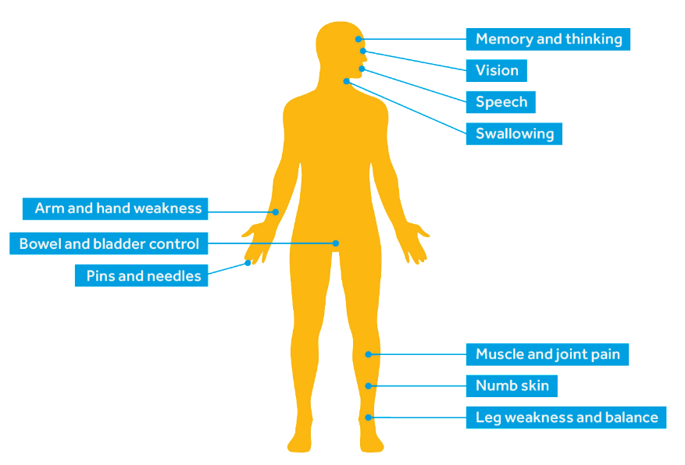
Effects of stroke
Notes:
Below are some key statistics you can use if they are helpful to your story:
Memory/thinking- Problems with memory and thinking are very common after a stroke and most people will have some difficulties.
Vision- About 60% of stroke survivors have visual problems immediately after their stroke.
Communication- One third of stroke survivors experience problems with communication – this can be in expressing information and speaking, but also in receiving and understanding information as well.
Swallowing- Around half of stroke survivors have problems swallowing.
Movement- 80% of stroke survivors experience problems with movement.
Incontinence- Around half of stroke survivors experience problems with bladder control, especially in the very early stages
Numbness- Around half of stroke survivors have impaired sensation.
Here are some additional statistics for the hidden effects of stroke:
Half of stroke survivors report fatigue.
Emotionalism affects about 1 in 5 stroke survivors in the first six months after stroke.
Approximately 50% of stroke survivors suffer depression in the first year following their stroke. Over half of stroke survivors experience symptoms of anxiety at some point in the 10 years after their stroke.
Some people’s behaviour changes. They may change their habits and start drinking tea instead of coffee, for instance. Some people become very irritable, or say and do things without thinking.
The effects of a stroke depend on two things:
where the stroke is in your brain
how much the stroke has damaged your brain.
These hidden effects can happen to people who do not have any other health problems or disabilities after a stroke. However they can affect many aspects of daily life, including your returning to work.

Slide 8
Vision after Stroke
About 60% of stroke survivors have visual problems after a stroke.
Reduces to around 20% after three months.
This means over 13,000 people in Wales.
Visual problems can vary between different stroke survivors depending on their stroke.
Notes:
Around 60% of stroke survivors have problems with their vision after a stroke, which equates to over 40,000 people in Wales alone which is a significant number.
What adds to the complexity is the fact vision can be affected in many different ways. As already mentioned, the effect of a stroke depends where the damage to brain cells occurred and this is the same for vision. Different stroke survivors can have vision problems which effect them in different ways.

Slide 9
Vision after Stroke
Central vision loss
Visual field loss
Problems with the nerves controlling eye movement
Visual processing problems
Notes:
Central vision loss - partial or complete loss of vision in one or both eyes
Visual field loss - most common is losing the right or left side of vision out of each eye – known as homonymous hemianopia
Nerve problems - this can include nystagmus, a condition that causes the eyes to move continually
Visual processing problems - affecting the ability to receive visual information that is then processed by the brain to find out what it means, such as colours or familiar objects or people

Slide 10
Other sight problems
Hallucinations
Dry Eyes
Light Sensitivity
Notes:
Those with visual field loss can also see things which aren’t there in their blind area, which may be the only time which somone notices their area of visual field loss.
Weakened muscles in the face and eyelid can also mean difficulty in closing eyelids fully or when asleep. This can cause dry eyes and irritation which requires treatment with lubricant or ointments to prevent other complications such as ulcers.
Stroke can also cause sensitivity to light as well, which may mean survivors can benefit from tinted glasses or sunglasses.

Slide 11
Impact of sight loss after stroke
Ability to drive – all for one month
Ability to work
Risk of falls
Care needs
Confidence and well-being
Made more complex by other impacts
Notes:
As I am sure many, if not all of you are aware, the impact of sight loss on an individual can be profound and complex. Stroke isn’t a condition which people will be aware of their risk for either, it is something which can occur at any time which means the sight problems they encounter have a sudden onset as well.
This means there can be a number of impacts.
Perhaps the most obvious would be on an individuals ability to drive. I met with the DVLA recently to discuss their approach and while they want to keep as many people on the road as possible this isn’t always going to be possible and some stroke survivors will lose their ability to drive. Anyone who experiences a stroke or TIA is automatically unable to drive for one month after their stroke, regardless of whether they actually experience sight loss as a result.
Someone’s employment may also be at risk as a result of sight loss. While there is some great assistive technology available these days these won’t be suitable for every occupation so there will be people unable to work, at least in their current job, as a result of stroke related sight loss.
An individual may also be at risk of falls, particularly as they may suddenly be living in a home which is no longer accessible for their needs.
Individuals may find that they now require care, whether it be formal care from social services or care from family members. Obviously this can have a drastic impact on an individual and their relationship with their partner and other family who are suddenly thrust into the role of carer, changing the nature of their relationship almost overnight.
Confidence is another risk factor as a result of sight loss, as someone can be experiencing a major change to their life with little to no warning. We already know that depression and anxiety are common after a stroke and visual problems may be one of those factors causing this.
What makes all of this more complex is there may be a variety of other symptoms experienced by a stroke survivor. They may not just be experiencing sight loss but also movement or balance problems, or any other combination of those effects I mentioned from a previous slide. This adds to the complexity of each individuals experiences and risks increasing care needs and lowering confidence and well-being further than just the impact of sight loss alone.

Slide 12
How do we help?
Stroke recovery services in the majority of Wales
Peer support groups and clubs
My Stroke Guide
Life After Stroke Grants
Stroke Helpline
Community Steps
Notes:
As an organisation, there are a number of things we do to help stroke survivors with their recovery.
The most direct would be our stroke recovery services which cover the majority of Wales. Their set up is slightly different depending on the health board, with some staff based directly in stroke units and others operating more through referrals from health services, but they work with stroke survivors to identify recovery goals, sign post and provide support to those who have recently experienced a stroke, up to a year after their stroke.
We also have our own stroke groups and work with other independent and affiliated stroke groups throughout Wales to promote peer support opportunities, which is something stroke survivors tell us is incredibly important to them. We know that this is a valued service which gives people the opportunity to discuss the challenges they face as individuals and meet other people who are going through similar experiences.
We’ve also recently launched a new online service called My Stroke Guide, which is an online tool to help people with their recovery from stroke. It contains a variety of information, such as videos and guides, as well as an online forum to try and ensure all stroke survivors are able to get support in their recovery regardless of whether there is a Stroke Association service in their area.
My stroke guide also has a section on vision, containing information on different sight conditions, videos and guidance on where to go for treatment and support. It can also be used by family, friends and carers to get information relevant for them.
We provide life after stroke grants of up to £300 to stroke survivors as well to help them with some of the costs they experience after having a stroke, such as equipment for the home to make it more accessible.
And we also run our stroke helpline to help provide advice and information for those who need it and have a brand new Wales wide project called Community Steps which will be working with stroke survivors to make communities in Wales more accessible.

Slide 13
Our other work
Campaigning
Cross Party Group on Stroke
Fundraising
Research
Awareness Raising
Know Your Blood Pressure events
Notes:
We also do other work as well to help promote awareness of stroke and importantly steps people can take to lower their own risk of stroke.
We do work directly with politicians, the NHS and local authorities in Wales to highlight the need of stroke survivors. One key element of this is the Cross Party Group on stroke which meets every quarter at the National Assembly to discuss stroke care in Wales. We have a meeting tomorrow for example where we’re going to be looking at the stroke workforce in Wales.
So we do activities such as coming to speak to you guys about stroke, as well as doing more public focused activities such as our Know Your Blood Pressure events where we offer free blood pressure checks to the public, at events like the Royal Welsh show for example.
We also fund research, having awarded over £40million in research funding over the last twenty years, into a wide range of different priorities around prevention, treatment and recovery from stroke.
And, like the vast majority of charities we also do fundraising, holding a range of different events such as our forthcoming Give a Hand and bake events in October, or our Santa Run in December.
I’ll be taking part in the Santa run, so if you want the opportunity to watch an unfit man run in a poorly fitting costume then feel free to sign-up and run yourself.

Slide 14
For more information:
Helpline: 0303 3033 100
Website: stroke.org.uk
Notes:
Together we can conquer stroke
Notes: End your presentation with a thank you and let people know where they can go if they want any more information.
Example: Thank you for listening.
[Do you have any questions?]
If you’d like more information about anything I’ve mentioned in my talk, please come and speak to me, or visit our website: stroke.org.uk.

