Slide 1
Dementia and Sight Loss
Sue Phelps
Country Director

Slide 2
Content
  Dementia
  Sight loss and dementia
  What can we do

Slide 3
What is dementia?
  Around 850,000 people with dementia in UK, more than 42,000 under 65
  Not a normal part of ageing
  Symptoms include problems with memory, thinking, concentration and language
  Dementia will get worse over time
  There are different types of dementia
Notes:
Dementia occurs when the brain is damaged by a disease such as Alzheimer’s disease
The symptoms someone experiences will depend on the parts of the brain and that are damaged and the type of dementia the person has.
Symptoms will be unique to the person but can include:
Problems recalling things that happened recently (memory loss)
Struggling with a familiar daily task such as managing finances (difficulties thinking things through and planning)
Difficulty finding the right word (language)
Losing track of what date or time it is (
Problems judging distances
Mood changes e.g. becoming unusually sad or anxious
How quickly dementia progresses will depend on the individual and can be influenced by a range of factors including age, type and lifestyle

Slide 4
Types of dementia
  Alzheimer’s disease
  Vascular dementia
  Mixed dementia
  dementia with Lewy bodies
  Frontotemporal dementia
  Rarer causes – Posterior Cortical Atrophy
Notes:
Alzheimer’s = most common. An abnormal protein surrounds brain cells and another protein damages their internal structure. In time, chemical connections between brain cells are lost and cells begin to die. Problems with day-to-day memory are often the first thing to be noticed.
Vascular = If the oxygen supply to the brain is reduced because of narrowing or blockage of blood vessels, some brain cells become damaged or die. This is what happens in vascular dementia. The symptoms can occur suddenly, following one large stroke. Or they can develop over time, because of a series of small strokes. Vascular dementia can also be caused by disease affecting the small blood vessels deep in the brain, known as subcortical vascular dementia. Many people have difficulties with problem-solving or planning, thinking quickly and concentrating. They may also have short periods when they get very confused.
Mixed = combination of dementias usually AD and Vad, symptoms will depend on types of dementia,
DLB = involves tiny abnormal structures (Lewy bodies) forming inside brain cells. They disrupt the chemistry of the brain and lead to the death of brain cells. Early symptoms can include alertness that varies over the course of the day, hallucinations, and difficulties judging distances. Closely related to Parkinson’s
FTD = In frontotemporal dementia, the front and side parts of the brain are damaged. Clumps of abnormal proteins form inside brain cells, causing them to die. At first, changes in personality and behaviour may be the most obvious signs. Depending on which areas of the brain are damaged, the person may have difficulties with fluent speech or forget the meaning of words.
PCA = tend to have a relatively well-preserved memory but experience problems with their vision, such as difficulty recognising faces and objects in pictures. They may also have problems with literacy and numeracy. These tasks are controlled by the back part of the brain, where the initial damage in PCA occurs.

Slide 5
Dementia and Sight loss
  250,000 people living with dementia and sight loss
  Caused by
    An eye condition
    Another health condition
    Normal ageing of the eye
    Dementia
Notes:
Cataracts
Stroke
Sight loss in dementia caused by…

Slide 6
Dementia and Sight loss
  Visual problems but healthy eyes
  Caused by the effect of dementia on the brain
  Specific dementias that may cause this
    Lewy body dementia
    Posterior cortical atrophy
    Alzheimer’s disease
Notes:
People with dementia may have visual problems directly related to the dementia, but their eyes are healthy – especially perception problems
Lewy body dementias = DLB and PDD

Slide 7
What to look for?
  Clumsiness
  Not being able to find things
  Problems with eating or drinking
  Avoiding doing things
  Not seeing well even with their glasses on
Notes:
If a person with dementia experiences any of these it would be a good idea to have an eye test
Sight loss is underdiagnosed in dementia due to ‘diagnostic overshadowing’ – everything attributed to dementia or not seen as worth bothering with ‘what difference will it make’
Prevalence of sight loss in dementia is higher than the overall population
Many cases of sight loss in dementia can be managed by wearing the correctly prescribed glasses
If someone has sight loss the following may be a sign of dementia
• becoming withdrawn or uncommunicative
• being clumsy or falling more
• having visual hallucinations
• holding things up close
• feeling confused and disorientated
• being startled by noises or people approaching. Some of the above may be due to dementia, but sight loss could be a contributory factor.

Slide 8
Living with dementia and sight loss
  Increased difficulties with new tasks
  Increased disorientation
  Difficulties with communication
  Mobility difficulties, increased risk of falls
  More visual mistakes
Notes:
In dementia orientation, recall, recognition and judgement are made worse by sight loss
People with dementia and sight loss experience increased feelings of isolation and fear
Person’s ability to cope with either condition is made worse by the other
Traditional coping strategies eg using visual prompts for memory problems are not as effective.
Increased disorientation eg difficulties recalling time and surroundings, less able to use visual clues to orientate sekf

Slide 9
Visual hallucinations
  Occur in dementia and sight loss
  Sight loss can increase hallucinations in dementia
  May be a misperception or misidentification
  More common in certain types of dementia
Notes:
DLB, Parkinson’s & Alzheimers

Slide 10
Living with dementia and sight loss
  Increased social isolation
  A range of losses – independence, activities, coping strategies
  Lack of understanding from others
  More likely to experience anxiety
Notes:
Important to support people with both conditions to be as independent and active as possible

Slide 11
What can be done?
  Regular eye tests
  Make sure glasses are ‘Current, Clean and Correct’
  Good lighting
  Colour contrast
  Adapt the environment
Notes:
Every 2 years unless advised otherwise – people with dementia can have eye tests and there are things that can be done
Adapt the environment – remove trip hazards, appropriate signage (good contrast and consistent), avoid reflective and patterned surfaces,

Slide 12
Eye tests
  Can be adapted for people with dementia
  Tell the optician about dementia
  Ask for a longer appointment or a specific time of day
  Go with the person, if appropriate
  Take a list of medications
Notes:
Ask for a home visit
Advise optician of any changes
Use someone you trust
A range of things to adapt the eye test

Slide 13
Communication
  Gain the person’s attention
  Explain who you are and what you’re doing
  Speak clearly, using simple short sentences
  Time
  Provide information in an accessible way
Notes:
Gentle touch or saying their name
Think about any other factors e.g. background noise or distractions, any other conditions – hearing loss
Stick to one idea or question at a time
Give the person plenty of time to take in what you’ve said and respond – OWL – Observe, Wait, Listen
Ask if guidance is needed
Braille, audio, large print

Slide 14
Aids and technology
  Think about what could help and when
  Test any devices
  Professional input
  Are there things in place already?
  Routine is important
Notes:
Technology isn’t for everyone but some people living with dementia and sight loss find technology beneficial

Slide 15
Diolch
Thank you
sphelps@alzheimers.org.uk

Slide 16


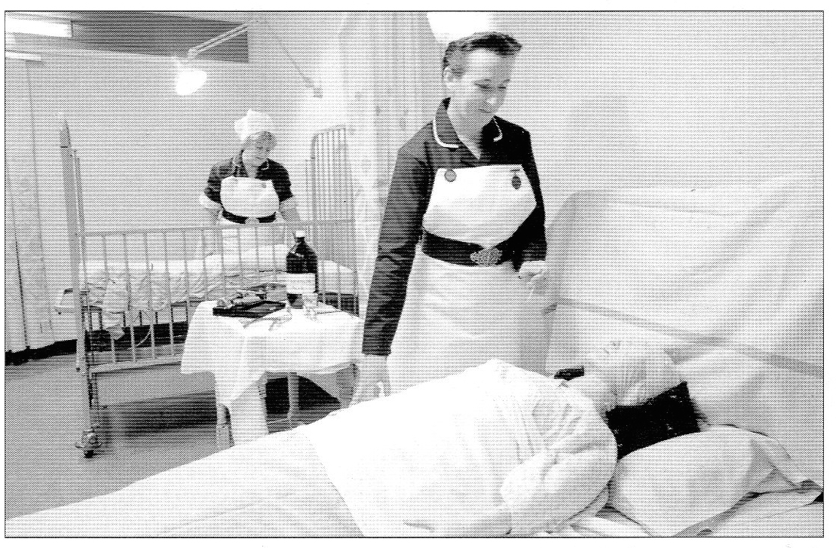
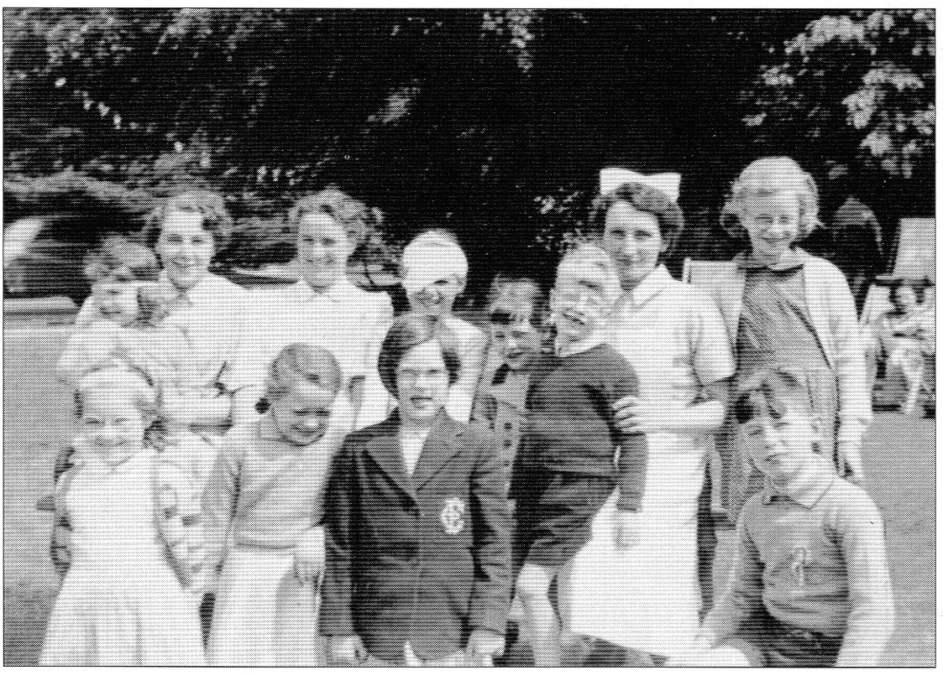
2018
Celebrating 70 years of the NHS in Wales

