Slide 1
Deafblind Cymru Delivery Plan and Framework for Action
How can we meet the needs of people with dual sensory loss?

Slide 2
Challenges
Identification
Information
Isolation
Independence
Interdependence
Notes:
Identification
It is estimated that there are over 20,000 Deafblind people in Wales, that is people who have Loss of Sight and Hearing to the extent that it significantly affects their lives. The problem is getting those people to identify that they are indeed Deafblind. The very term Deafblind conjures up the idea of someone with no Light Perception and total hearing loss and so most people who have acquired deafblindness will simply accept the limitations caused by their conditions as part of growing old.
Deafblind Cymru needs to find ways of reaching their potential membership so that these people are aware that there is support available and enable the person with Dual sensory loss to identify and access the support that they require both from Deafblind Cymru and from wider society.
Information
The person with acquired dual sensory loss will find themselves out of contact with their usual sources of information and find increasing problems accessing that information that drops through the letterbox. If the person themselves does not know what support they need, to access the information, they will not be able to communicate this need to the doctor or the electricity company to ensure the need is met.
The challenge for Deafblind Cymru is to ensure that people with Dual Sensory loss are enabled to demand access to information in the format that will enable them to access services they are entitled to.
Isolation
The loss of a single sense, sight or hearing is in itself isolating but when the two are combined, isolation rapidly sets in. Even at relatively low levels of the combined loss, people can begin to withdraw from social situations and lose confidence about everyday challenges such as crossing the road or going to the shops. As they drop out of the normal cycle of life, they become harder to reach with the information they need to enable them to break out of their restricting circumstances .
The Challenge that Deafblind Cymru faces is how to reach isolated people to provide them with support in becoming less isolated.
Independence
Isolated and unable to access information the person with Dual sensory loss can rapidly lose their independence, becoming reliant on the good will of family and friends to undertake the simple tasks that Sighted and hearing people take for granted.
Our Challenge is to support the person with dual sensory loss to retain as much independence as possible, and ensure that they are provided with the support they need to do this
Interdependence
Dual sensory loss can lead to loss of confidence and a sense of being useless. Responsibilities they have been happily undertaking for years are dropped as they lose their confidence.
Deafblind Cymru seek to identify people early on in the progression of dual sensory loss and encourage them to volunteer and support them to utilise their skills for the benefit of their peers such as taking a leadership role in a social group or becoming a befriender to a housebound person with Deafblindness.

Slide 3
The Framework
Statutory Environment
Partnership
Resources
Notes:
Statutory environment
The Social Care and Well being act provides for an environment where the needs of Deafblind people must be met by organisations such as local government, social services and NHS Trusts. The act also specifies the requirement for working across boundaries so that there is a duty for governmental organisations to work with relevant third sector organisations.
Partnership
The Act in my opinion provide an opportunity for a change in the way that services are delivered. By working in truly constructive ways across traditional boundaries of activity we can support each other in providing the services our constituents require. There must be mutual respect and open dialogue between organisations to enable support in place of duplication of effort.
Resources
In a time of ever reducing financial resources in both the government and charitable sectors, we need to ensure that changes are made in the way that services are funded. Speaking from the point of view of the Charitable sector, there needs to be a change in the way that Grant funding is allocated. Services developed under a three year grant funding often cease with the end of the funding because the funder wants something novel – the current flavour of the month. There is an urgent need for continuity to ensure that there is not a cyclical loss of personnel and expertise as one funding cycle comes to an end whilst the next has not yet started.

Slide 4
The Plan
Identification – Contact
Information - Communication
Isolation - Community
Independence - Confidence
Interdependence – Co-operation
Notes:
Identification – Contact
Deafblind Cymru is happy to provide support to organisations to enable them to identify and help their deafblind constituents. We want to make sure that those who come in contact with people with sensory loss are aware of the issues, how to identify and signpost people with dual sensory loss to Deafblind UK..
Information – Communication. Deafblind Cymru can provide support to ensure that service organisations are aware of the specific communication needs of the person with dual sensory loss and are enabled through advice and training to deliver the information required.
Isolation – Community.
Prevention is better than cure, Deafblind Cymru is seeking to identify people with dual sensory loss before the conditions have got to the stage where social isolation has become established. We seek to enable the person retain their confidence and social networks, through the services we provide our members are empowered to overcome the sense of isolation and remain engaged with their community and find support from their deafblind peers.
Independence – Confidence.
Deafblind Cymru aims to enable the person with dual sensory Loss to retain their Independence and to live their life in the way they wish, as far as practically possible. We recognise that access to information and having services which meet their needs are absolutely vital in this. Deafblind Cymru seeks to enable both the deafblind person and the people providing the services they need to access, to operate in a way that fosters the individuals confidence to provide and use the services.
Interdependence – Co-operation.
For our members interdependence is found in the way we encourage them to contribute what they are able to give to other members – volunteering to phone housebound members of the community, taking up responsibilities in the members groups.
Deafblind Cymru is a small organisation with limited resources, it is only by working together with other organisations, enabling them to, identify communicate with and support effectively, those with dual sensory loss that we can really make the difference needed for the deafblind community in Wales.

Slide 5
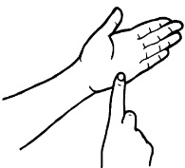
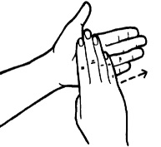
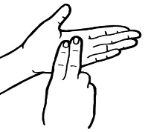
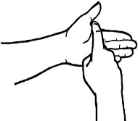
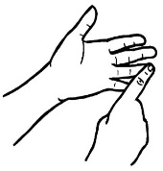
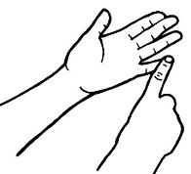
T
H
A
N
K
Y
O
U

