Slide 1
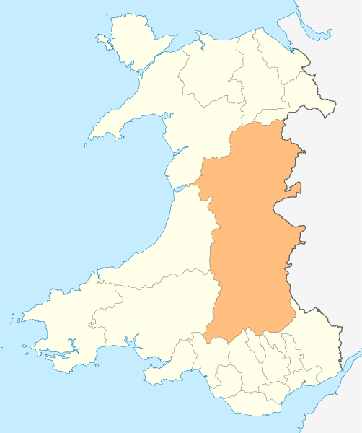
Delivering Care Closer to Home
Powys

Slide 2
Some Facts about Powys
Covers over 5,000 square kilometres - about 25% of Wales
135,000 residents - less than 5% of Wales
11.1% of population aged 75 and over - Wales 8.8%
No District General Hospital

Slide 3
Bringing Care Closer to Where People Live (Primary Care)
Cataract post-operative eye examinations in primary care
Shropshire Optometrists
Suspect Glaucoma and Ocular Hypertension
Optical Coherence Tomography & Visual Fields
Primary Care +

Slide 4
Bringing Care Closer to Where People Live (Community Hospitals)
Out-patients
Day Case Surgery
Wet AMD

